Slide 1


Unveiling the Facts: How Safe is Flying?

Slide 2
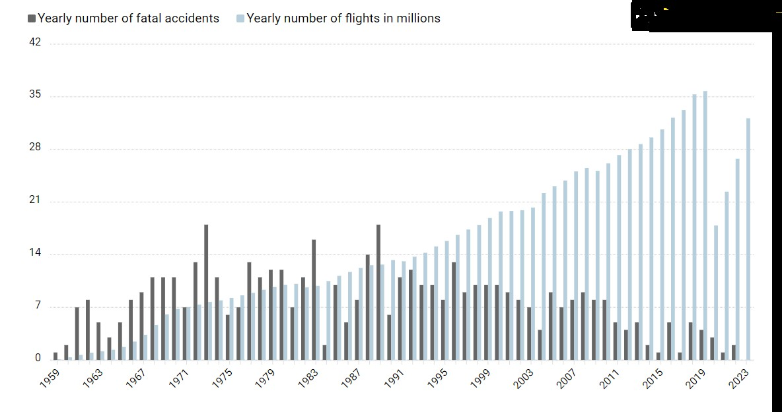


Slide 3
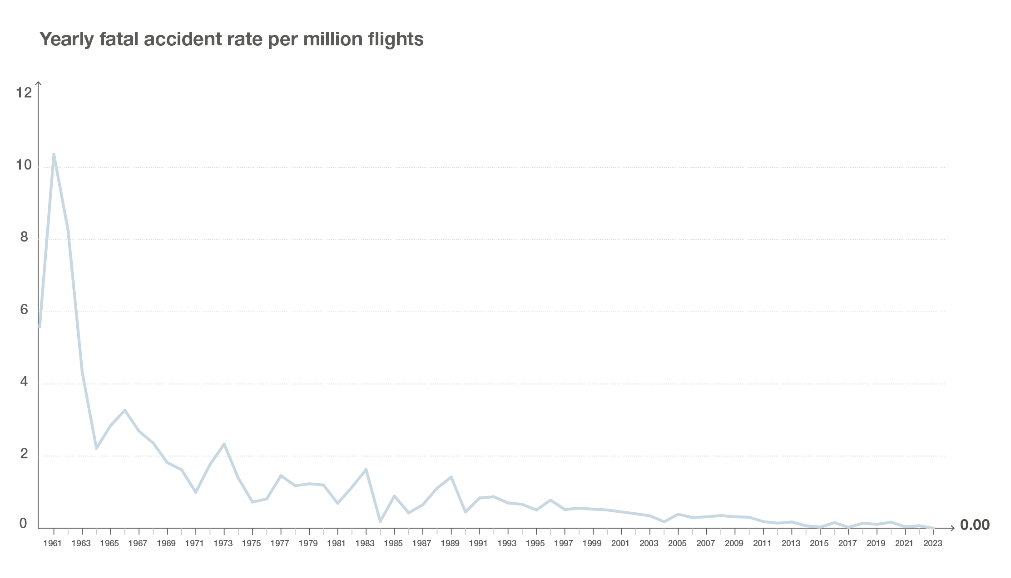


Slide 4
Airlines and Aviation Authorities multifaceted approach
Efficient flight training to enable better crew performance
Enhanced crew resource management
Increased situational awareness (including weather conditions)
Immediate response to EGPWS warnings
Updating EGPWS software and Terrain/Obstacle/Runway database in a timely manner
Good decision-making and execution
The continual reduction in accident rates has been achieved by an ongoing commitment of the commercial aviation industry to enable a safe aircraft to be safely operated in a safe air transport system.
Effective regulation, a strong safety culture, and improvements in training

